Slide 1
Spring 2020 Undergrad Research Presentation
Dr. Mark Turner
Christopher Feldman
Matthew Ha
Rokas Ogorodnikas

Slide 2
Overview of Project
Dr. Mark Turner

Slide 3
Introduction of Students
Dr. Mark Turner

Slide 4
openMDAO Overview
Chris Feldman

Slide 5
The OpenMDAO Framework
OpenMDAO is an optimization platform in python.
The framework allows for simple yet efficient file parsing to find user defined inputs and outputs from specified files before altering or recording them for use in minimizing the objective function.
For our work, we used openMDAO to edit independent variables for thickness and camber in the Tblade-3 input files.
Bash scripts can also be included to run during the optimization
For these projects, bash scripts were used to run T-Blade3, Mises, and python scripts containing objective functions.

Slide 6
The OpenMDAO Framework
For these projects, the steps carried out by openMDAO were as follows:
Create variables for inputs and outputs.
Specify the files containing these inputs and outputs.
Set up the parsing so that openMDAO can access the independent variables in the input files and overwrite them, as well as access and record the outputs.
Set up the iteration process for optimization by specifying:
Which of the independent variables to iterate on
Initial values for those independent variables
Upper and lower limits on the independent variables
Convergence tolerance for the process

Slide 7
T-Blade3 Overview
Matthew Ha

Slide 8
T-Blade3 Framework
Parametric 3D blade geometry builder
Formally 3DBGB
Curvature based parameterization utilizing uniform rational basis spline
Version 1.2.2 obtained from http://github/GTSL-UC/T-blade3
Compiled and setup onto personal Linux Box
T-Blade3 geometry input obtained from https://github.com/GTSL-UC/T-Blade3/blob/master/inputs/NACA_thickness_cases/OGV_midspan_section/LE55/mises_instructions.pdf
OGV Mid-Span Section LE55
3dbgbinput.3.dat
spanwisecontrolinputs.3.dat

Slide 9
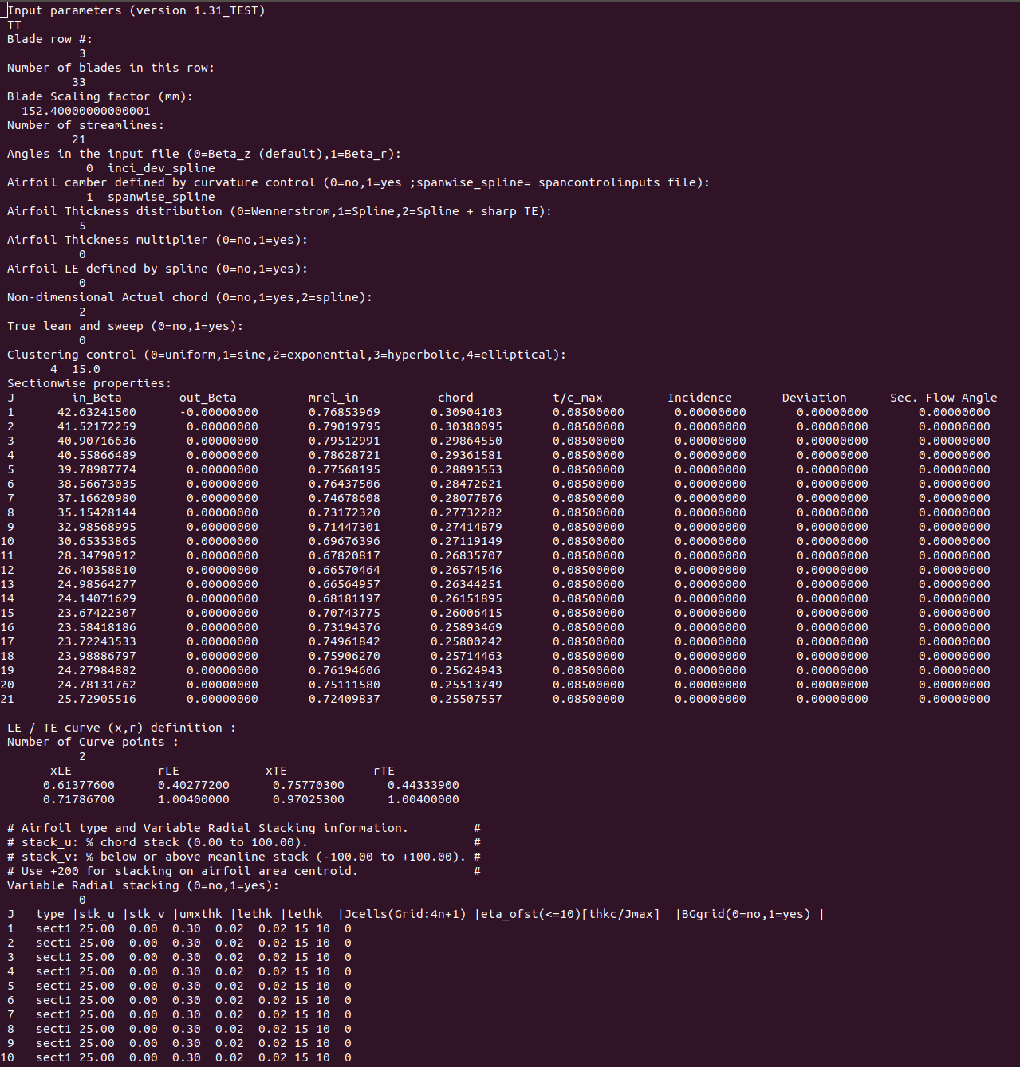
T-Blade3 Input File
3dbgbinput.3.dat

Slide 10
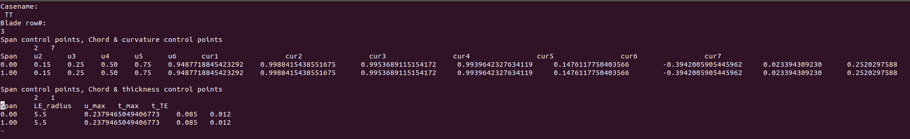
T-Blade3 Input File
spancontrilinput.3.dat
Notes:
This input file was modified to change our blade to a constant span blade.

Slide 11
T-Blade3 Output
CAD model geometry created from T-Blade3
blade3d.TT.dat
Number of points: 241
Number of sections: 21
Number of blades in row: 33

Slide 12
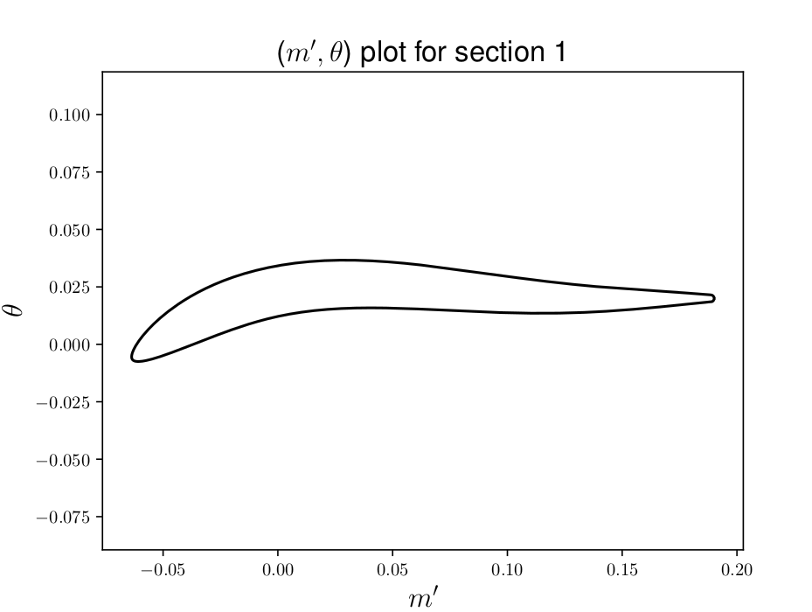
T-Blade3 2-D Output Sample Section 1

Slide 13
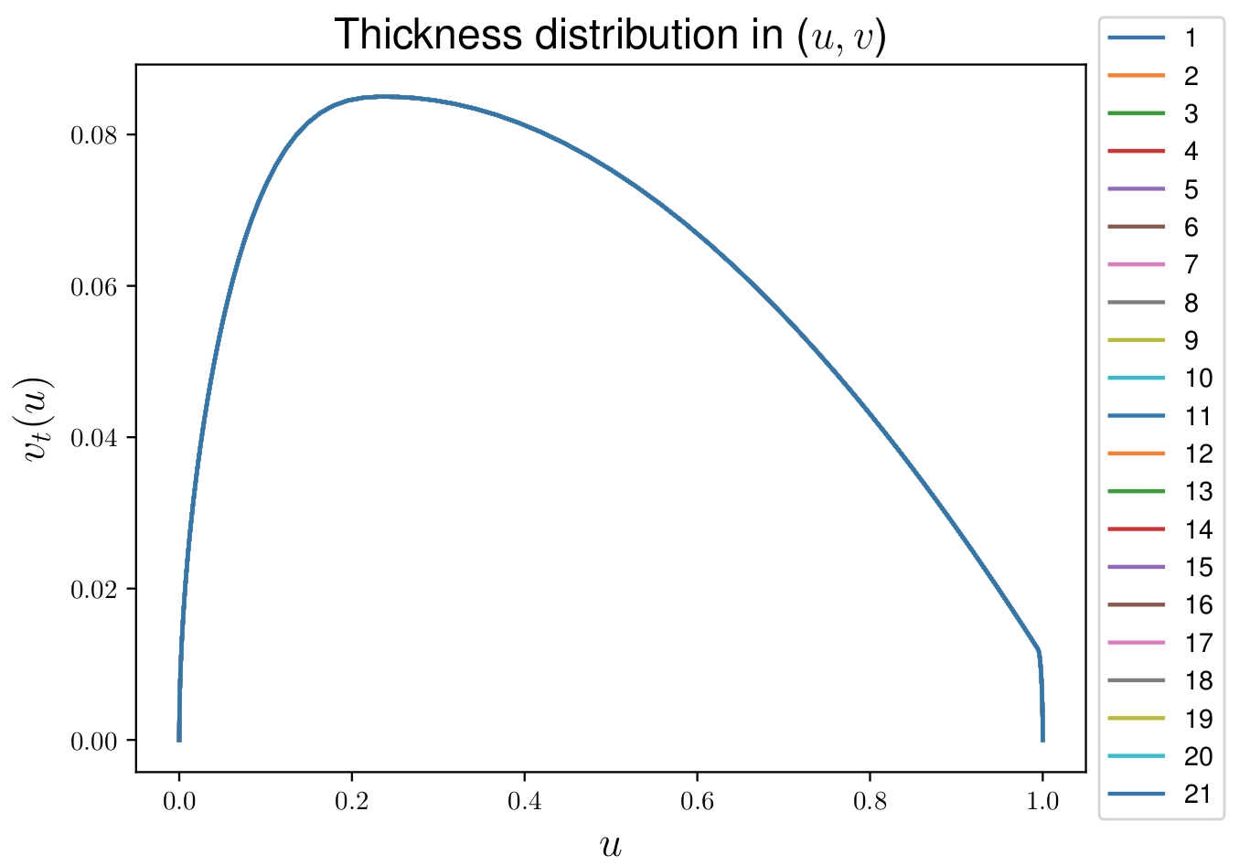
Thickness Distribution

Slide 14
MISES Overview
Rokas Ogorodnikas

Slide 15
MISES Framework
MISES is a flow solver made up of a collection of programs.
Created by MIT’s Mark Drela.
Version 2.70 supplied by Dr. Mark Turner.
MISES programs that were used:
ISET
ISES
IPLOT
MISES is able to achieve near machine precision

Slide 16
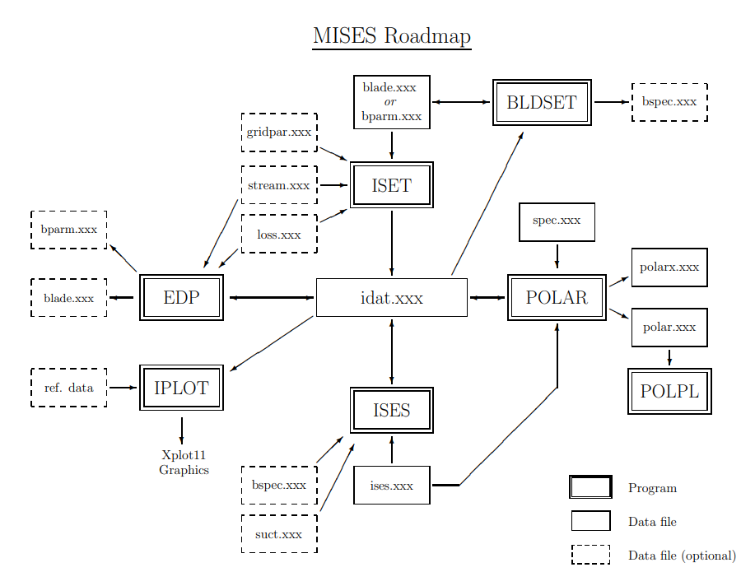

Slide 17
Simplified MISES Roadmap
T-Blade3
blade.xxx
ISET
idat.xxx
ISES
Program
data file
IPLOT
Xplot11
Graphics
Program functions:
ISET - elliptic grid generator.
ISES - flow solver which uses Newton’s method to solve nonlinear system that is derived from the Euler equations coupled with the integral boundary layer formulas through the displacement thickness.
IPLOT - post-processing utility used to generate blade surface, and contour plots.

Slide 18
Supercritical CO2
Matthew Ha

Slide 19
Supercritical CO2 Compressor
100 MW multistage axial compressor design
Inlet Temperature: 75 C
Inlet Pressure: 2.21 MPa
Outlet Pressure 25 MPa
Working Fluid: S-CO2
Mass Flow Rate: 440 kg/s

Slide 20
Why S-CO2
Low critical pressure and temperature
7.377 MPa, 304.13 K
High density and convective heat transfer coefficient
Allows for a reduction of volume for turbomachinery
1/100 size of steam engine
Low viscosity fluid
Low compressibility factor
Improves overall efficiency of thermal cycle

Slide 21
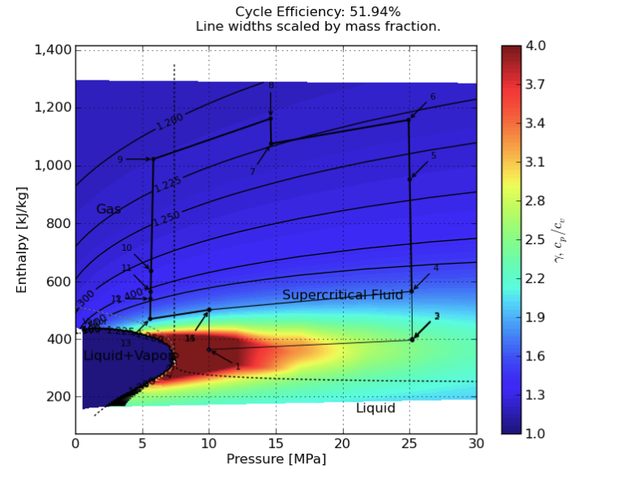
Implementation of S-CO2
S-CO2 conditions simulated by modifying gamma and Reynolds number in simulation

Slide 22
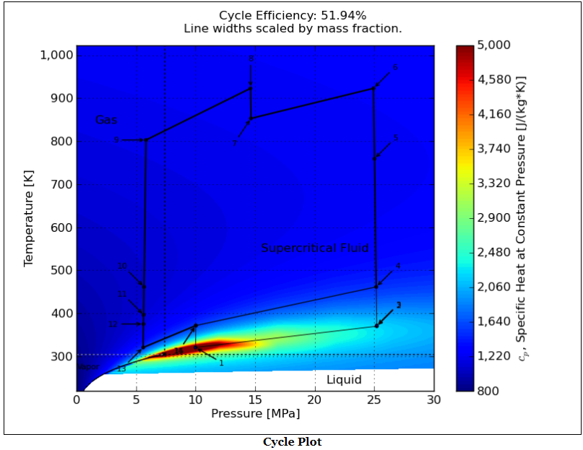
Supercritical CO2 Cycle Plot

Slide 23
Reverse Engineering Target Blade
Chris Feldman

Slide 24
Reverse Engineering a Target Blade with T-Blade3 Parameters
Goal: take an airfoil from airfoil tools and reverse engineer it to find its T-Blade3 parameters.
Starting with fitting NACA thickness profiles, this capability could be expanded to other blade types.
The only information about the target airfoil required is a file containing its (u,v) coordinates.

Slide 25
The Objective Function: Sum of the Least Squares Difference
1: Split blades into 4 sections: Leading Edge, Top, Bottom, and Trailing Edge
2: Using the blade generated in T-blade3:
For the LE and TE, use linear interpolation to get u as a function of v.
For the Top and Bottom, use linear interpolation to get v as a function of u.
3: Calculate the Least Squares difference between the target blade and the linear interpolations of the blade generated in T-blade3.
For LE and TE, take the difference in u.
For Top and Bottom, take the difference in v.
4: Sum the square differences across the four sections.

Slide 26
The Objective Function: Sum of the Least Squares Difference
The splitting into LE, TE, Top, and Bottom sections is based on the (u,v) coordinates. The exact ranges for the coordinates in each section greatly affect the optimization process, so trying different ranges can be beneficial.
i.e: LE is where u =< 0.25; TE is where u > =0.75; Top is where 0.25<u<0.75 and v is above the mean camber line; and Bottom is where 0.25<u<0.75 and v is below the mean camber line.
For the following cases, the split between Top and Bottom was based on if the v coordinate was above the average v value for the points between the LE and TE, since each u coordinate did not have two v values from which to calculate a mean camber.

Slide 27
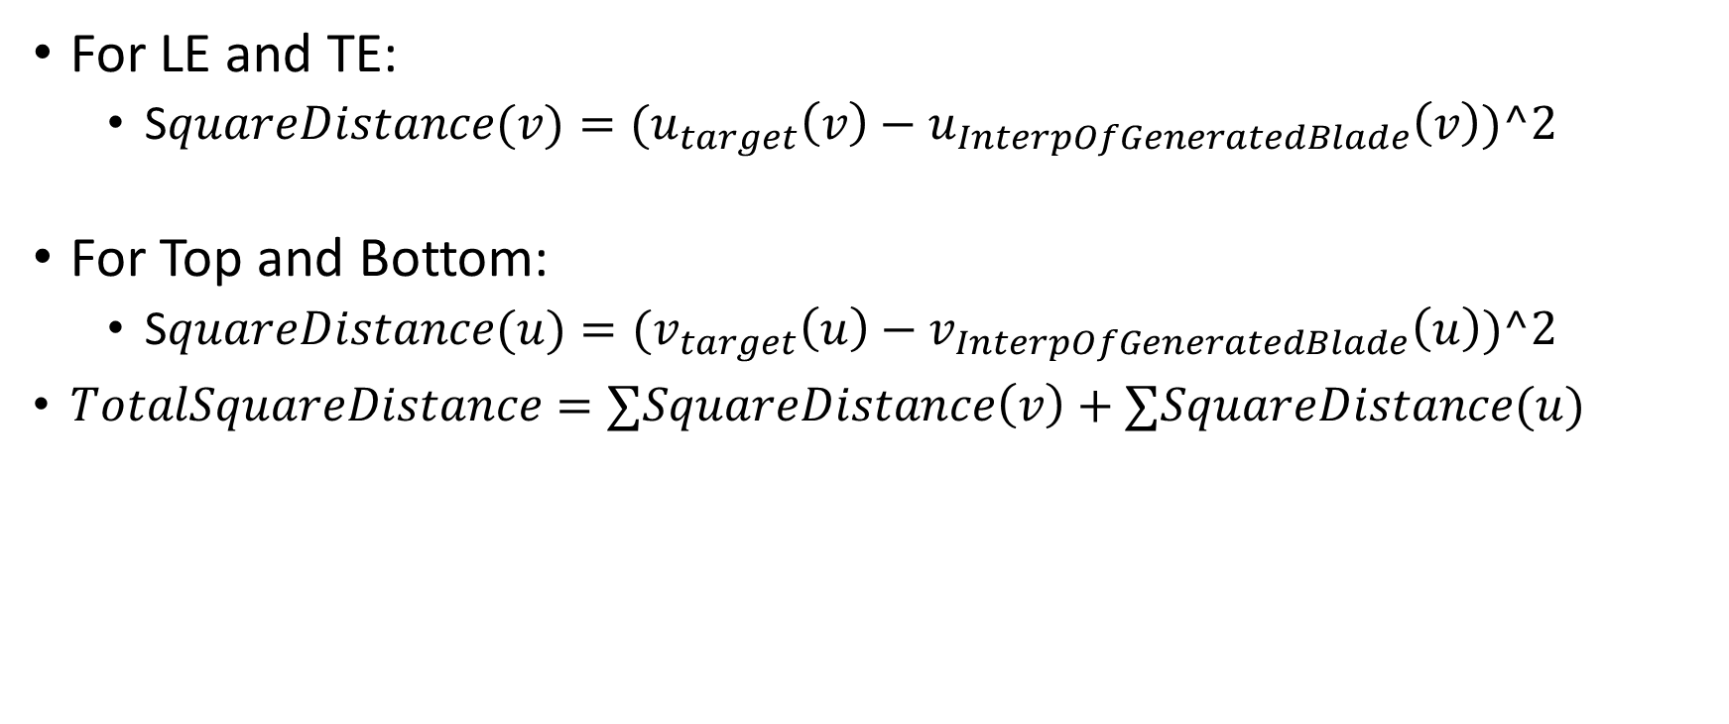
The Objective Function: Sum of the Least Squares Difference

Slide 28
Alternative Objective Function: Weighted sum of the Least Squares Difference
The previously shown method of calculating the sum of least squares difference has one major shortcoming:
The concentration of points is highest at the LE and TE, so the optimization will favor solutions that optimize these regions over the Top and Bottom regions of the blade.
This issue is not as apparent in NACA series blades, but becomes glaringly visible when reverse engineering blades of other series.
To overcome this issue, the objective function can be weighted by the average distance between each point and its neighboring points on the airfoil.
Thus, the process is the same as before, except the square distance at each (u,v) point is multiplied by the average distance between it and its two neighboring points.
This may cause issues with the fit on the LE and TE since a parameter change that gives a better weighted result on the Top and Bottom may decrease the fit on the LE and TE

Slide 29
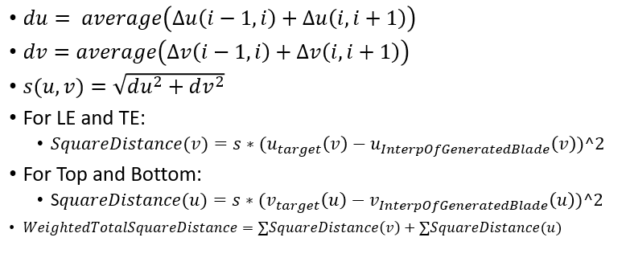
Alternative Objective Function: Weighted sum of the Least Squares Difference

Slide 30
Minimizing the Objective Function
The OpenMDAO framework in python was used to minimize the objective function.
Since the goal was to reverse engineer a blade based on thickness and camber, the following inputs were used:
Max thickness
In and out beta angles
Chordwise location of max thickness
Trailing edge thickness
Leading Edge radius
Camber curvature points
Slope of the trailing edge dy_dx_TE

Slide 31
Bounds on the Input Values
For the following cases, the following boundaries were used for the input variables:
Thickness: 0.00001 to 1
LE radius: 0.00001 to 6
u max: 0.00001 to 0.8
t TE: 0.00001 to 1
In beta: 0.00001 to 90
Out Beta: -90 to -0.00001
Cur1: -1 to 1
Cur2: -1 to 1
Cur3: -1 to 1
Cur4: -1 to 1
Cur5: -1 to 1
Cur6: -1 to 1
Cur7: -1 to 1
dy_dx_TE: -6 to 0
Driver tolerance: 1e-6
Partial derivative step size: 0.00001

Slide 32
Case 1: NACA 2412
Two different tests to fit the NACA 2412 are included in the following slides.
The difference between these tests is in how the LE and TE ranges were specified.
For test A, the LE encompassed points where u =< 0.25, and the TE encompassed points where u >= 0.75. These ranges were chosen just as a starting point.
For test B, the LE encompassed points where u =< 0.15, and the TE encompassed points where u >= 0.95. These ranges were chosen based on the chordwise locations of the camber curvature control points in the spancontrolinputs file for T-Blade3, as the first point is located at u=0.15, and the final point is at u=0.95.
The reason for doing two tests here was to show that the LE and TE range definitions can affect the outcome of the optimization process.

Slide 33
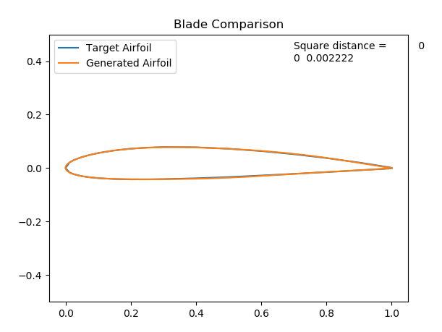
Case 1a: NACA 2412
Thickness: 0.11958142
LE radius: 5.96439462
u max: 0.31147535
t TE: 0.00023768
In beta: 3.81638604
Out Beta: -3.83309896
Cur1: -0.10299912
Cur2: 0.61932135
Cur3: 0.5619591
Cur4: -0.29485988
Cur5: 0.71988217
Cur6: -0.30534409
Cur7: -0.49186083
dy_dx_TE: -0.13972451
Square Difference: 0.002222

Slide 34
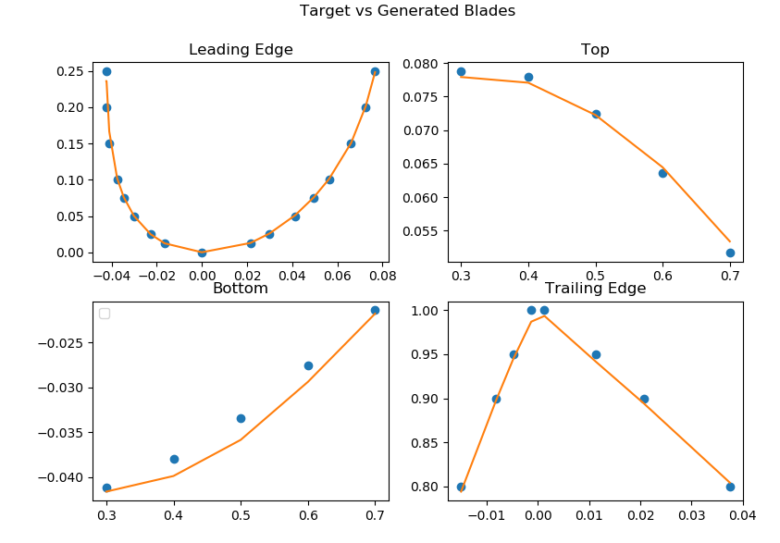
Case 1A: NACA 2412
Thickness: 0.11958142
LE radius: 5.96439462
u max: 0.31147535
t TE: 0.00023768
In beta: 3.81638604
Out Beta: -3.83309896
Cur1: -0.10299912
Cur2: 0.61932135
Cur3: 0.5619591
Cur4: -0.29485988
Cur5: 0.71988217
Cur6: -0.30534409
Cur7: -0.49186083
dy_dx_TE: -0.13972451
Square Difference: 0.002222

Slide 35
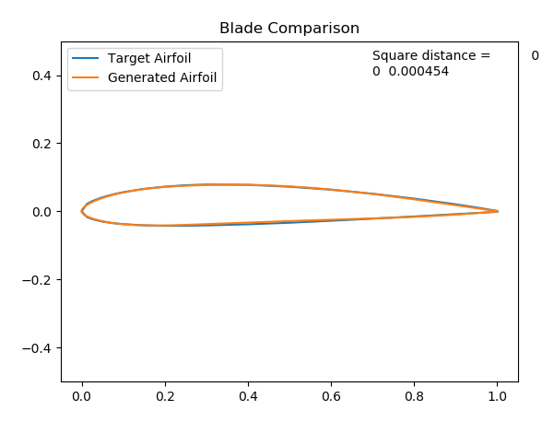
Case 1B: NACA 2412
Thickness: 0.11493681
LE radius: 4.73647344
u max: 0.26731537
t TE: 0.001
In beta: 3.70390405
Out Beta: -3.70390794
Cur1: 0.29695852
Cur2: 0.29995203
Cur3: 0.43865086
Cur4: 0.71951371
Cur5: 0.00038163
Cur6: -0.34051683
Cur7: 0.00687997
dy_dx_TE: -0.13969341
Square Difference: 0.000454

Slide 36
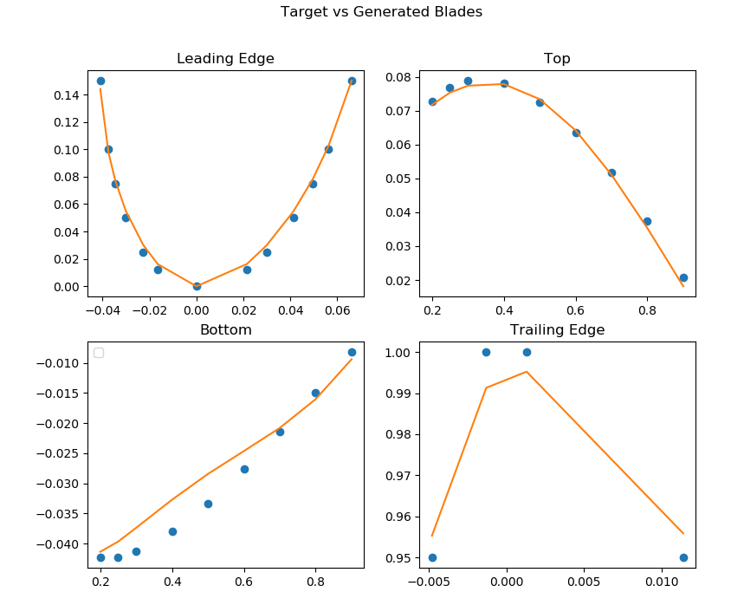
Case 1b: NACA 2412
Thickness: 0.11493681
LE radius: 4.73647344
u max: 0.26731537
t TE: 0.001
In beta: 3.70390405
Out Beta: -3.70390794
Cur1: 0.29695852
Cur2: 0.29995203
Cur3: 0.43865086
Cur4: 0.71951371
Cur5: 0.00038163
Cur6: -0.34051683
Cur7: 0.00687997
dy_dx_TE: -0.13969341
Square Difference: 0.000454

Slide 37
Case 1: NACA 2412 Conclusions
Graphically, test A looks to be an almost perfect fit, looking better than test B.
Numerically, test B appears to be a better fit than test A.
Since the goal is to reverse engineer the blade geometry, test A’s results are more satisfactory.
Here, test B only had 4 points in the TE section, while test A had 8.
A wider range of points for the LE and TE in this case was more beneficial, but including too many points can lead to poor fitting as well.

Slide 38
Case 2: Eppler 1098
The Eppler 1098 airfoil was chosen to test reverse engineering blades that did not follow NACA parameters.
For this blade, the weighted square distance objective function was used, as previous attempts using the non-weighted objective function saw large discrepancies between the Top and Bottom of the target and generated blades.

Slide 39
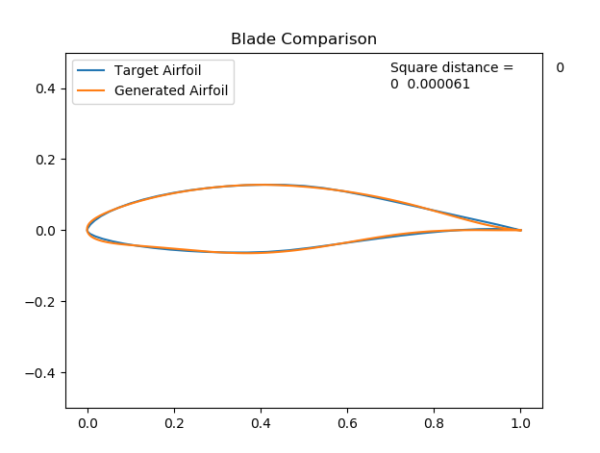
Case 2: Eppler 1098
Thickness: 0.19201449
LE radius: 4.9848335
u max: 0.38487556
t TE: 1.00006597e-5
In beta: 4.4845662
Out Beta: -4.50852069
Cur1: -0.6485295
Cur2: 0.82986524
Cur3: 0.06354977
Cur4: -0.20008813
Cur5: 0.86331539
Cur6: -0.55184912
Cur7: -0.97902271
dy_dx_TE: -0.05101172
Weighted Square Difference: 0.000061

Slide 40
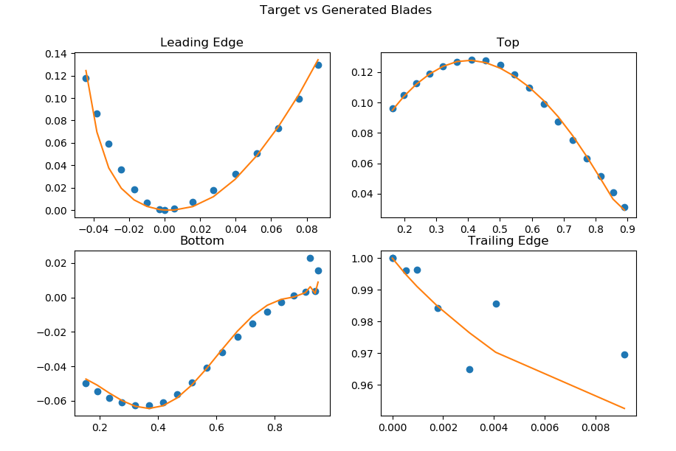
Case 2: Eppler 1098
Thickness: 0.19201449
LE radius: 4.9848335
u max: 0.38487556
t TE: 1.00006597e-5
In beta: 4.4845662
Out Beta: -4.50852069
Cur1: -0.6485295
Cur2: 0.82986524
Cur3: 0.06354977
Cur4: -0.20008813
Cur5: 0.86331539
Cur6: -0.55184912
Cur7: -0.97902271
dy_dx_TE: -0.05101172
Weighted Square Difference: 0.000061

Slide 41
Case 2: Eppler 1098 Conclusions
The fit was not quite as strong for the Eppler 1098 as for the NACA 2412, but it was still a fairly close fit.
There were some issues splitting the blade into the four sections. These were due to having just one value as the cutoff between the Top and Bottom sections.
To improve the fit, the convergence tolerance in the openMDAO script could be made tighter.

Slide 42
Some Known bugs/issues
Occasionally, the inputs for T-blade3 chosen by openMDAO will produce coordinates unreadable by the code for the objective function.
This generally happens when inputs have values that they realistically probably should not, such as location of maximum thickness being at 99% chord.
The solution to this is to simply edit the upper and lower limits on the independent variables in the openMDAO script.
Finding the mean camber line of the blades can be an issue, as the blades from airfoil tools do not always have two v values for each u.
Thus the value chosen to split the airfoils into Top and Bottom sections can be a guessing game.
This also creates difficulty when the camber on the Bottom is negative, as having a single value split the top and bottom can result in points that should be on the top end up in the bottom in the objective function and vice versa.

Slide 43
Observations/Conclusions
Since the input files for T-blade3 are set up for NACA cases in this project, the code is able to effectively reproduce them almost exactly.
The NACA blades also perform better with the non-weighted sum of square distances than with the weighted sum of square distances.
The Eppler 1098 blade’s results show promise that other non-NACA series blades can be reverse engineered with this objective function.
When switching the objective function between the sum of square distances and the weighted sum of square distances, the tolerance value in the openMDAO script may require modification
The weighted sum of square distances requires a higher magnitude of accuracy for the tolerance
This can greatly increase the time required to converge, but also more reliably results in an accurate estimation for the parameters.

Slide 44
Compressor Design and Blades
Rokas Ogorodnikas

Slide 45
Compressor Design
Compressor
Stage 1
Stage 2
Stage 3
Rotor
Blade
Stator
Vane

Slide 46
Vanes
Used Outlet Guide Vane (OGV) with a Leading Edge (LE) of 5.5
This geometry was downloaded from GTSL GitHub Repository.
Mayank Sharma’s previous geometry evaluation was used as a starting point.
The goal was to minimize the loss coefficient (Zeta) constrained to an exit angle (S2).
The following parameters were used:
Thickness: 0.000 - 1.00
LE radius: 5.5
u max: 0.40
t max: 0.085
t TE: 0.012
In beta: 6
Out Beta: 5
Chord Multiplier: -0.18
Inc: 0
Dev: -10.99
Cur1: 0.99639952
Cur2: 0.77658344
Cur3: 0.58568635
Cur4: -0.35767983
Cur5: -0.40824278
Cur6: 0.02339430
Cur7: 0.25202975

Slide 47
Constrained Optimization of Stage 1 Stator with S-CO2
Matthew Ha

Slide 48
Setup
project_multivar_RO.py developed
Framework taken from Viars Minithesis documentation for 10 variable optimization
Viaris OpenMDAO model used to minimize zeta while satisfying a constrained exit flow angle to attempt and minimize pressure drop
Downstream angle constrained to both 0 and 1 degree
Script successfully runs:
T-Blade3
Mises
OpenMDAO as an Optimizer tool

Slide 49
OpenMDAO Output
Iterations: 11
Function Evaluations: 34
Gradient Evaluations: 8
Optimization Successful

Slide 50
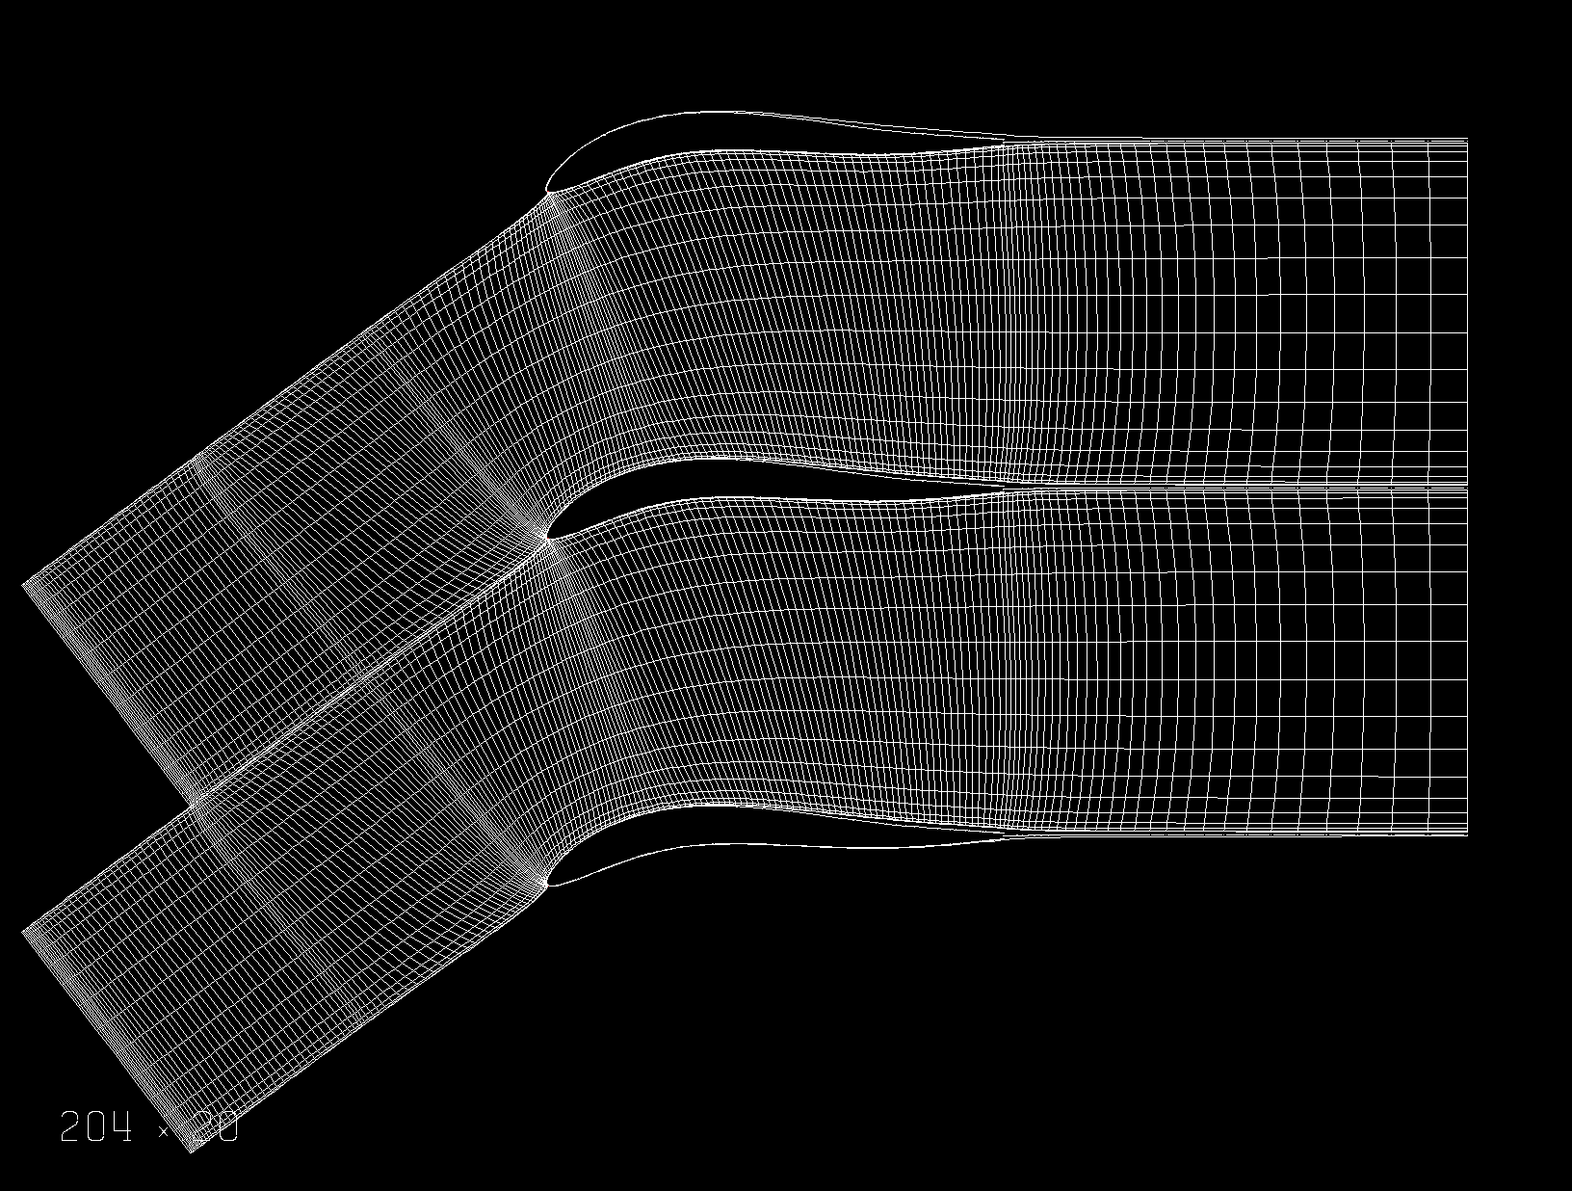
Grid Generation

Slide 51
Results With an Exit Angle of 0 deg and Gamma = 1.8
Zeta = 0.02557
Omega =0.01515
M1 (abs) = 0.5906
M2 (abs) = 0.4346
S1 = 0.74085 @ 36.533 deg
S2 = 0.00000 @ 0.000 deg
u max:
Inc:
Dev:
Cur1: 0.94877
Cur2: 0.99884
Cur3: 0.99569
Cur4: 0.99369
Cur5: -0.39420
Cur6: 0.02339
Cur7: 0.25203

Slide 52
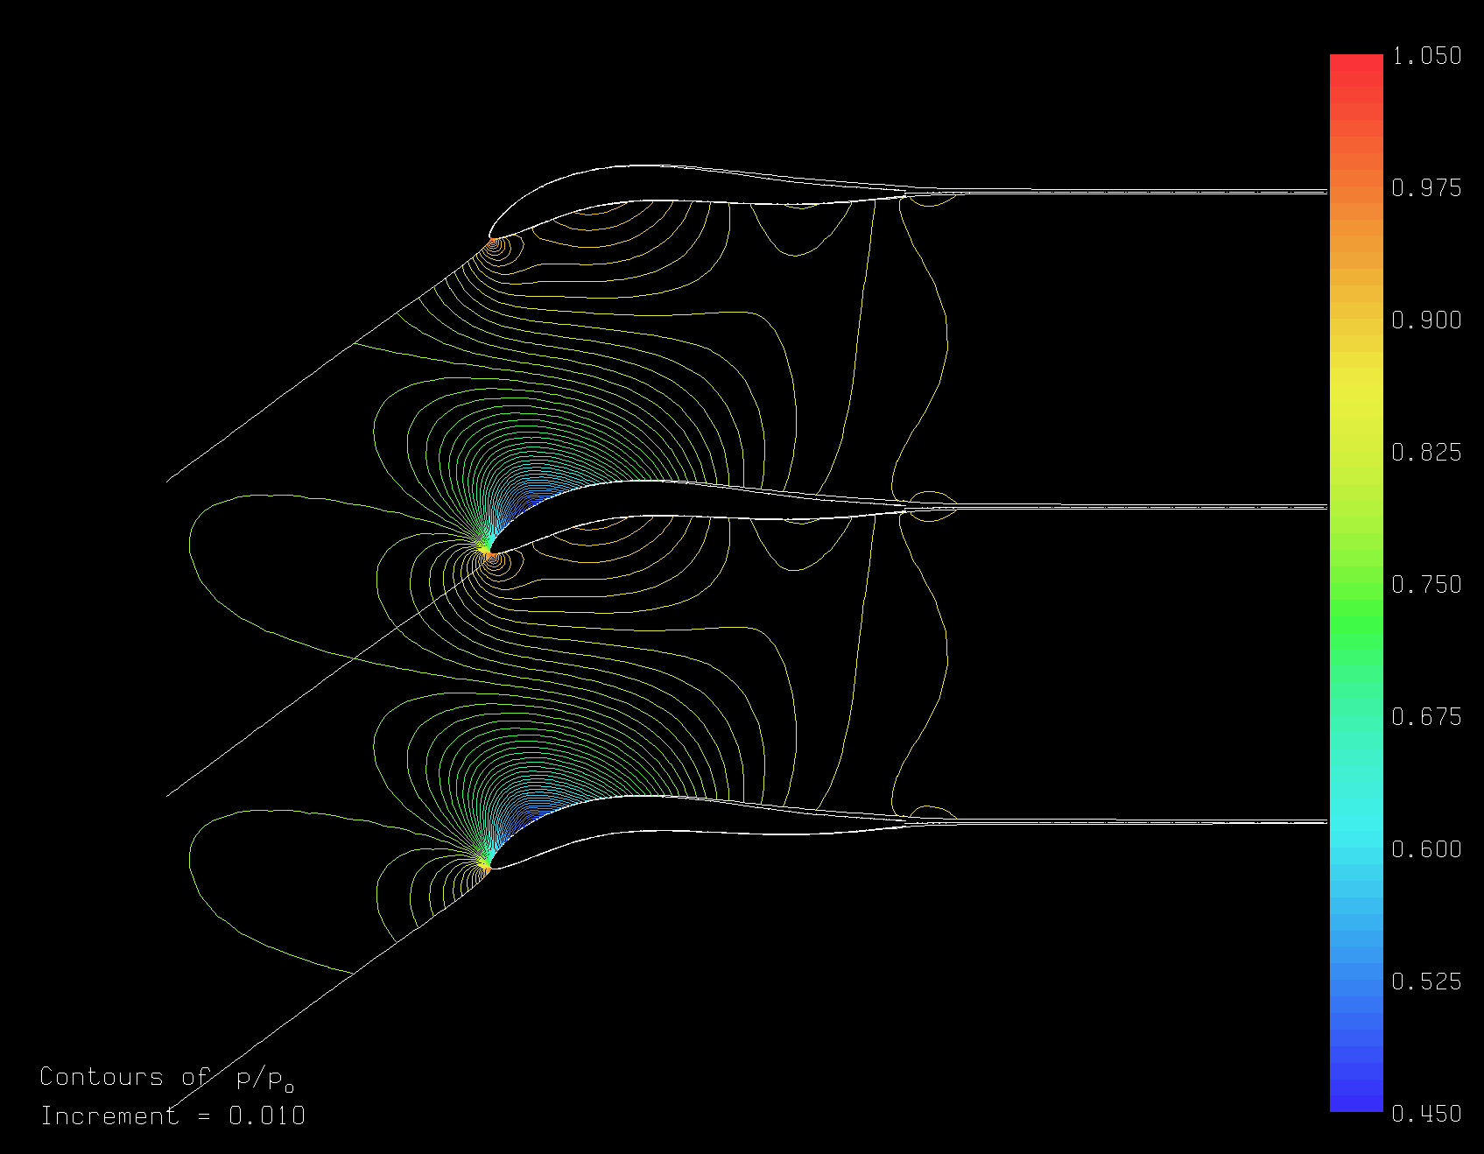
Optimized Vane Pressure Contour

Slide 53
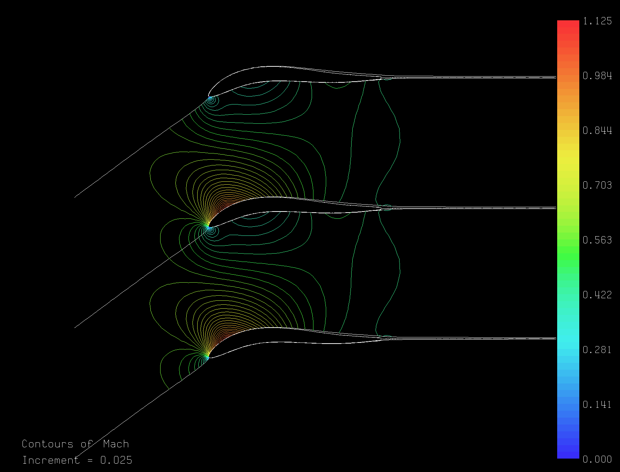
Optimized Vane Mach Number Contour

Slide 54
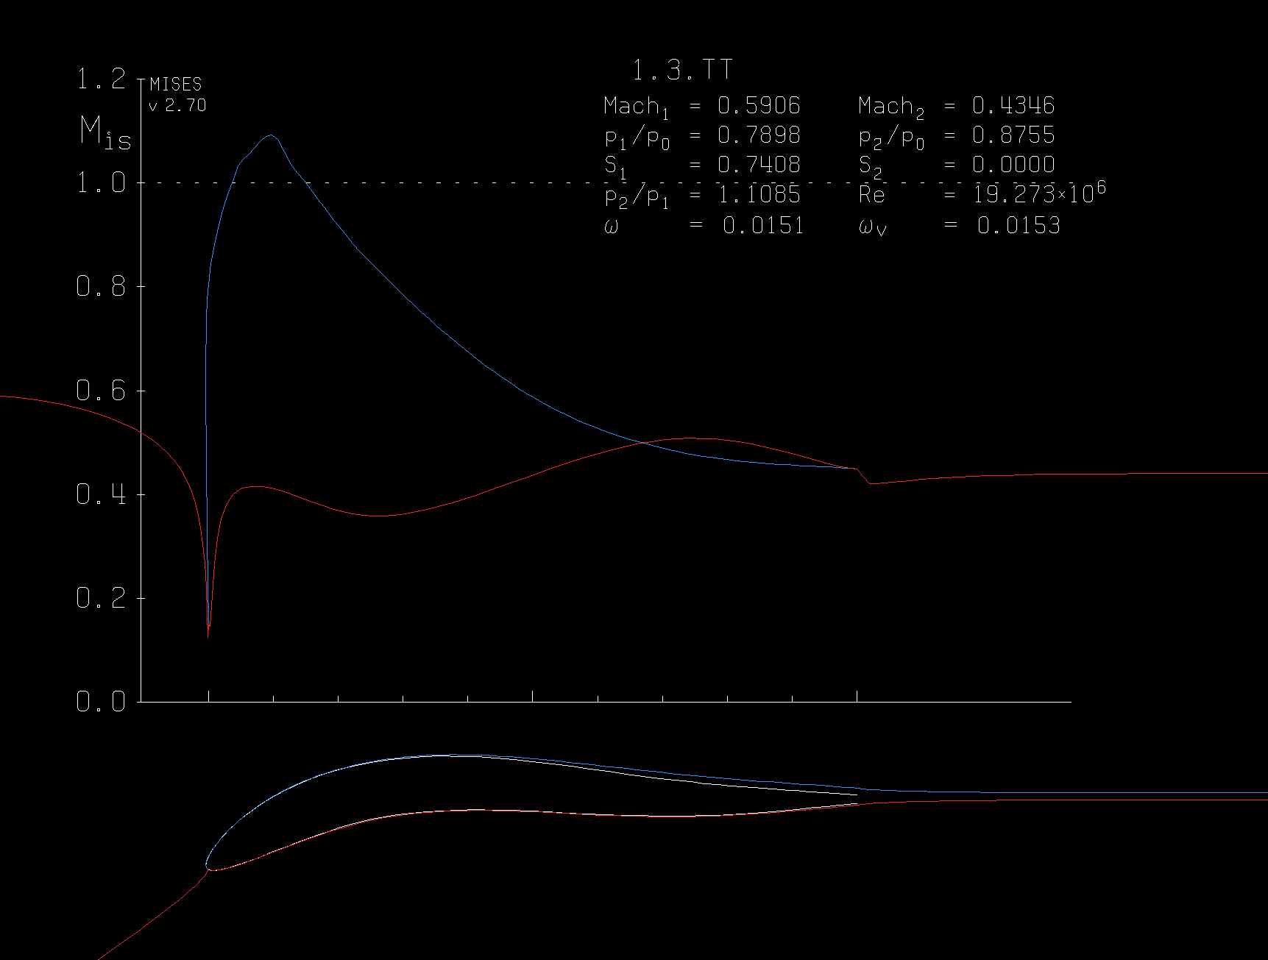
Optimized Vane and Surface Mach Number

Slide 55
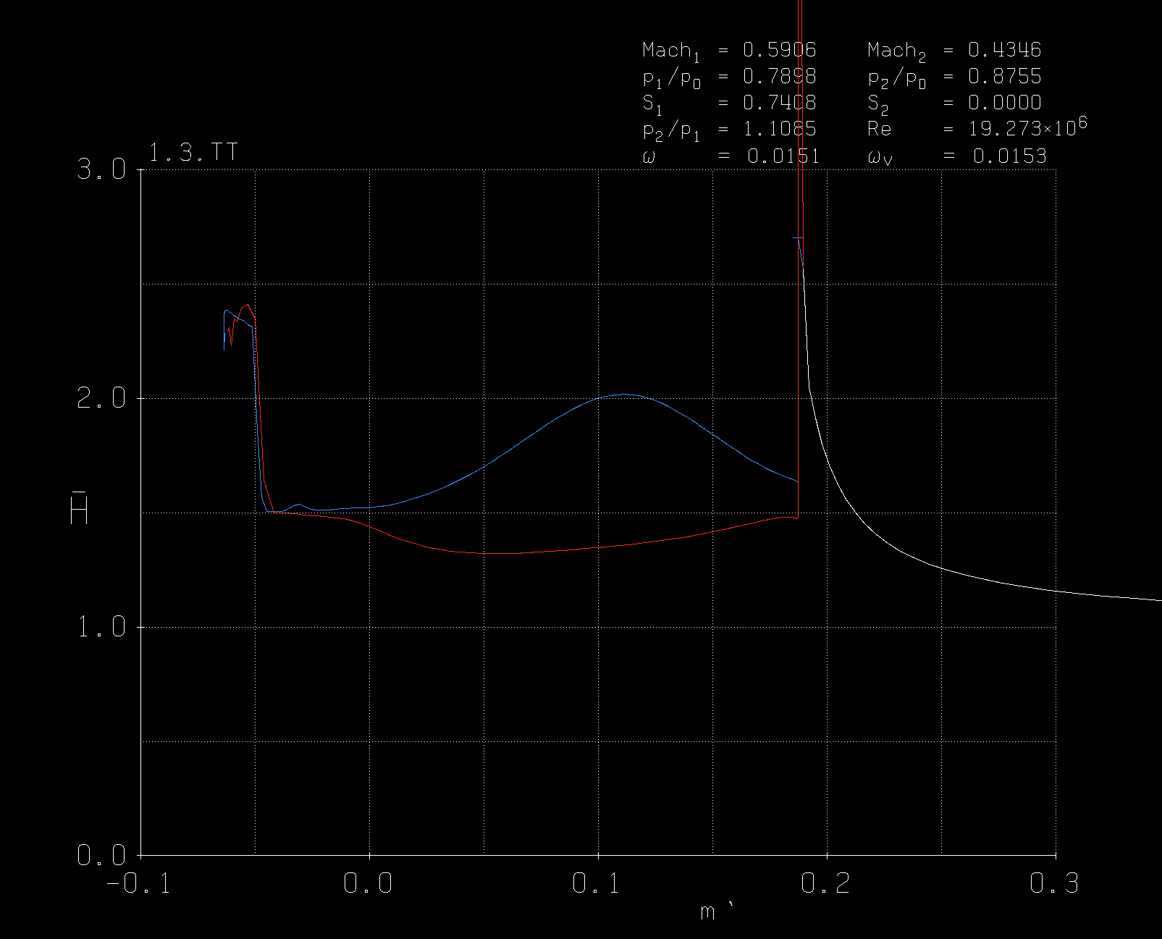
Optimized Vane Shape Factor

Slide 56
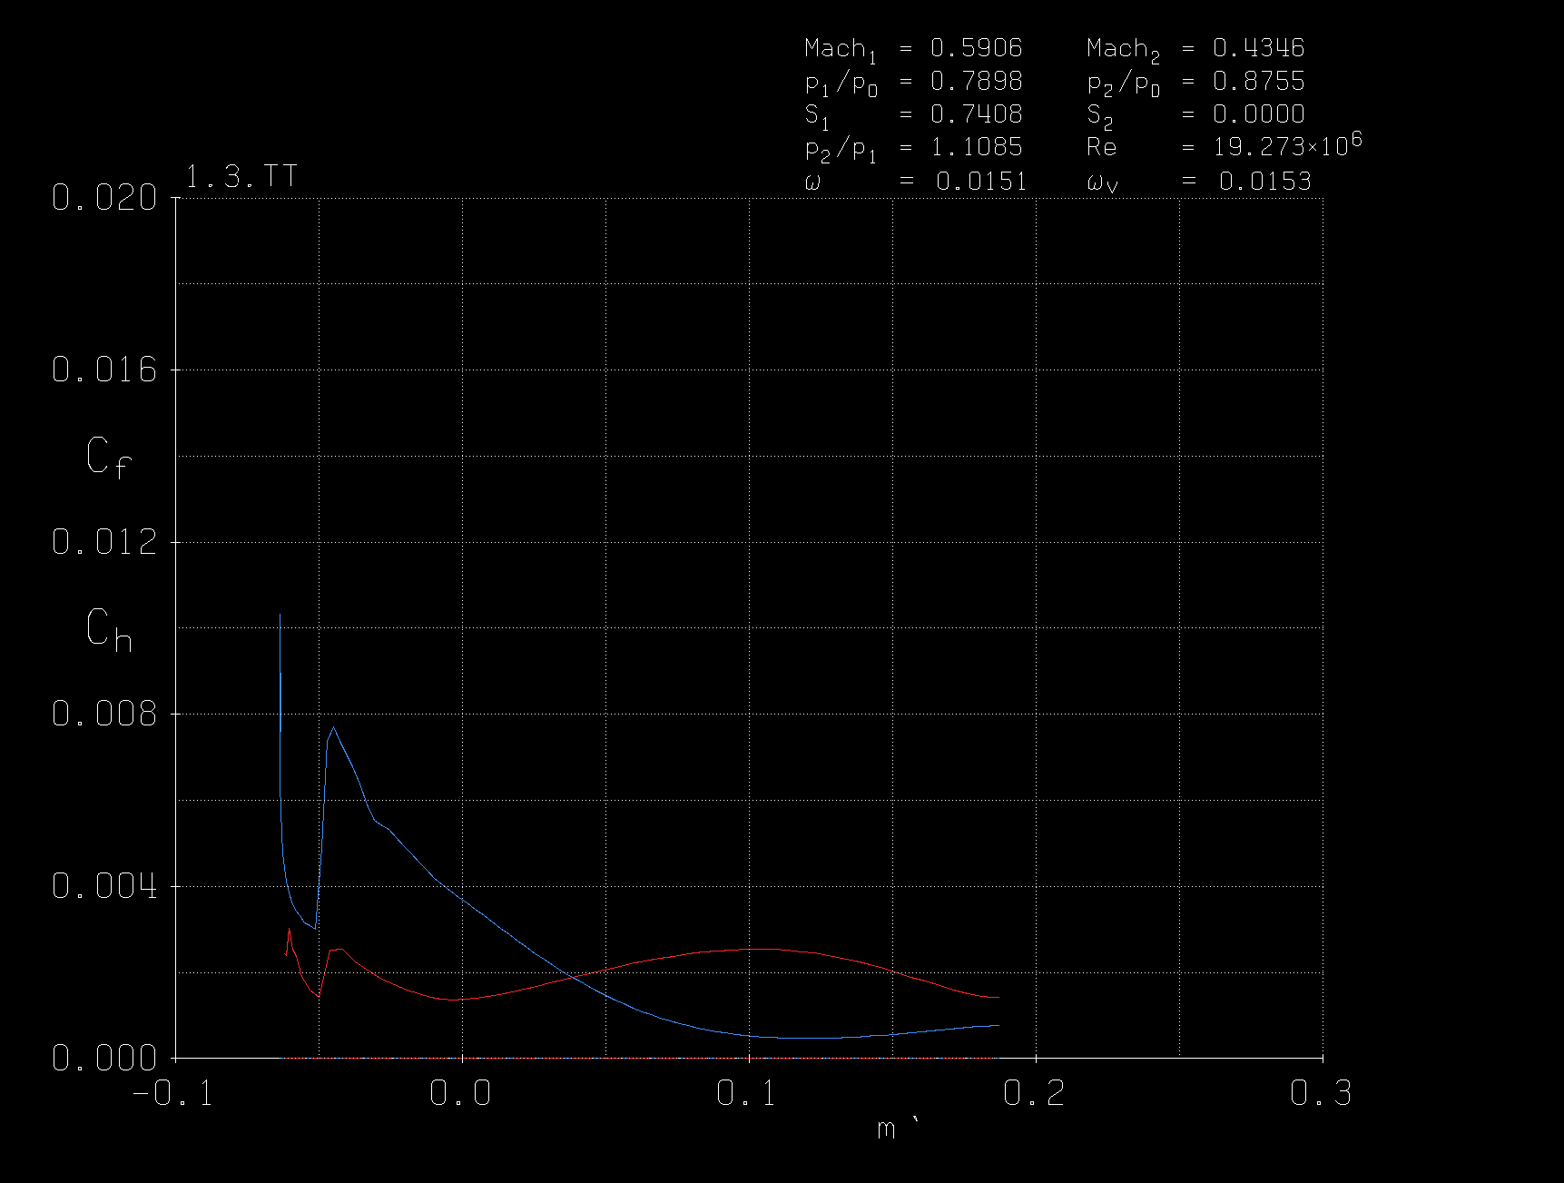
Optimized Vane Skin Friction Coeff.

Slide 57
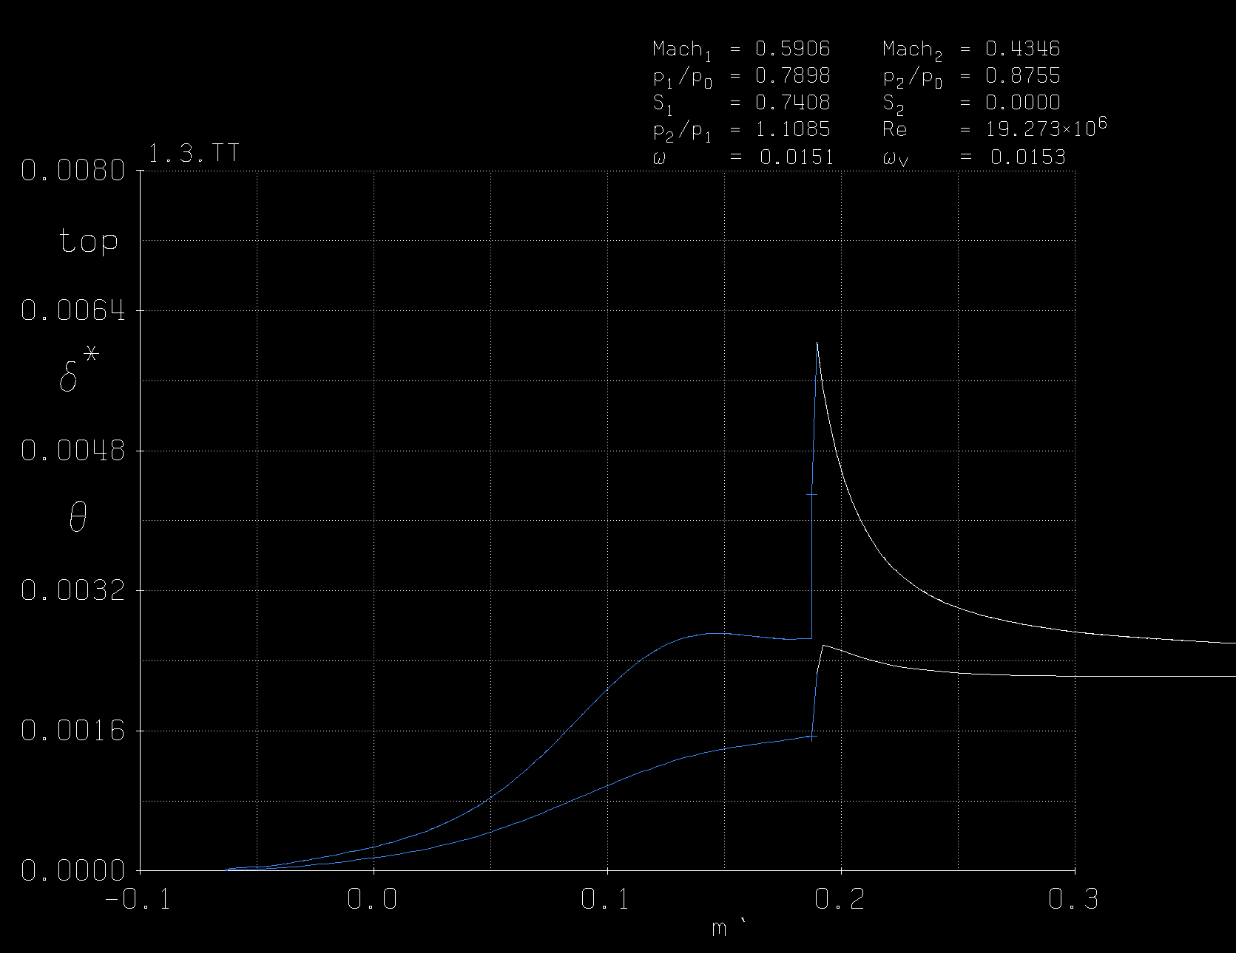
Optimized Vane Displacement & Momentum Thickness (Pressure Side)

Slide 58
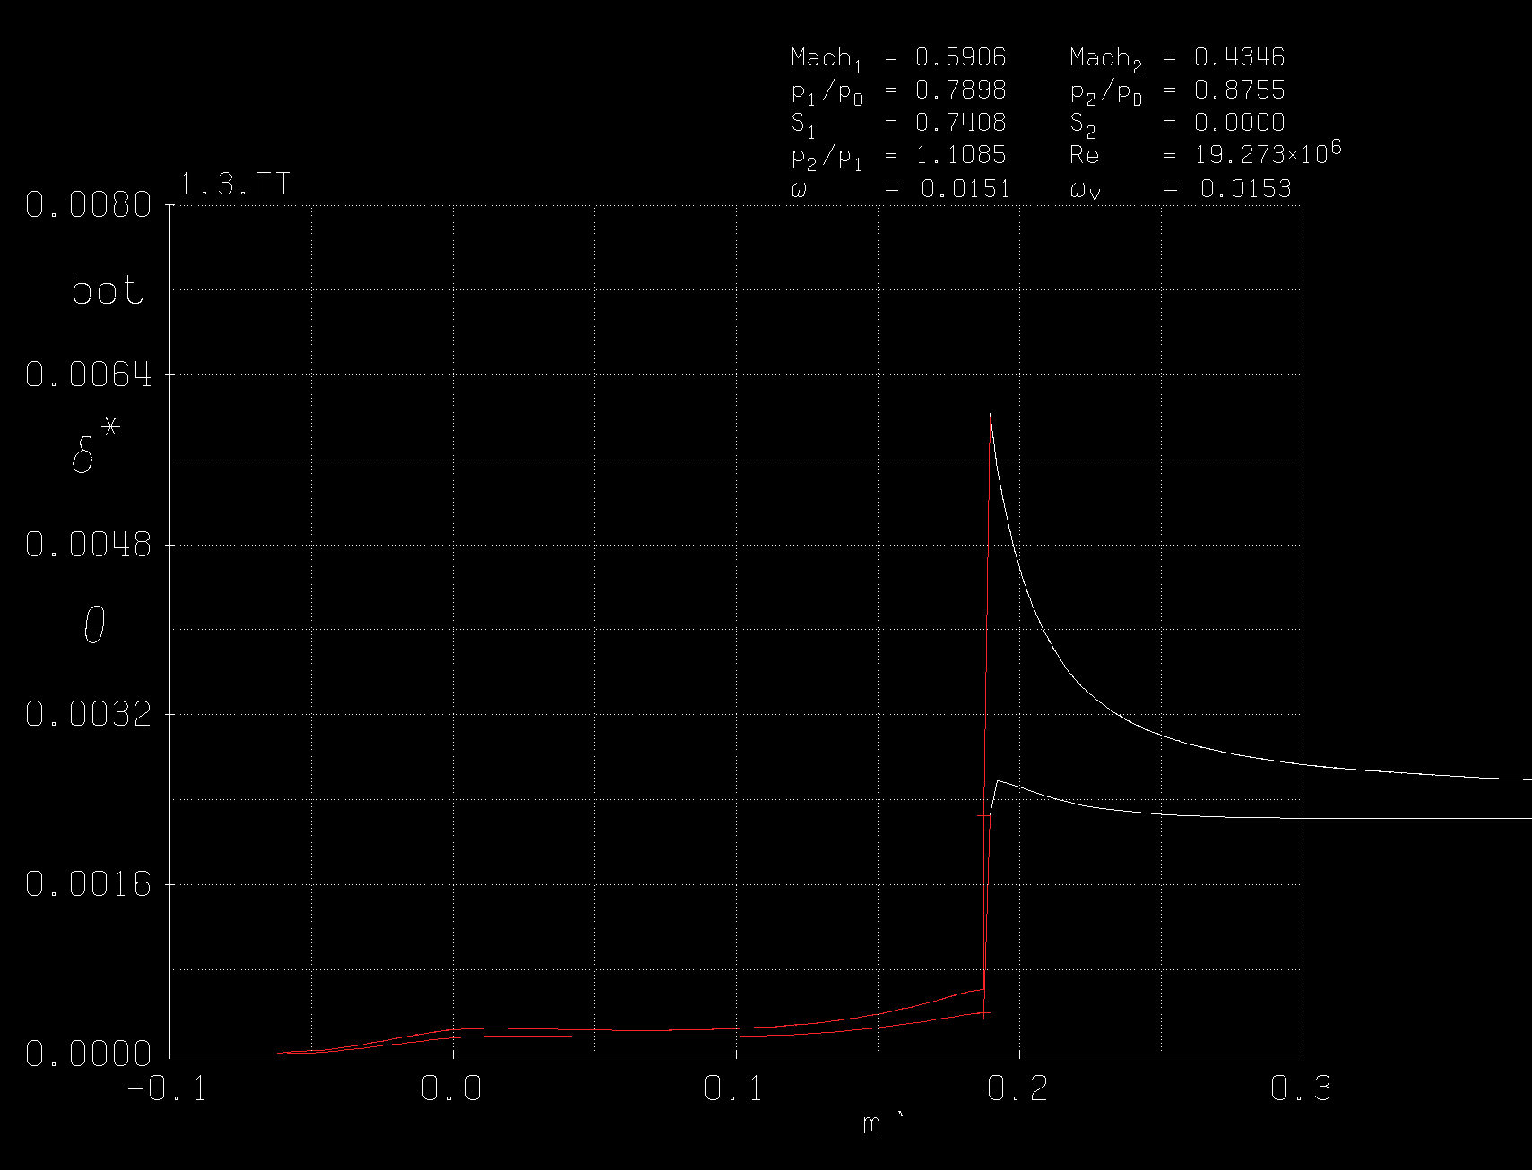
Optimized Vane Displacement & Momentum Thickness (Suction Side)

Slide 59
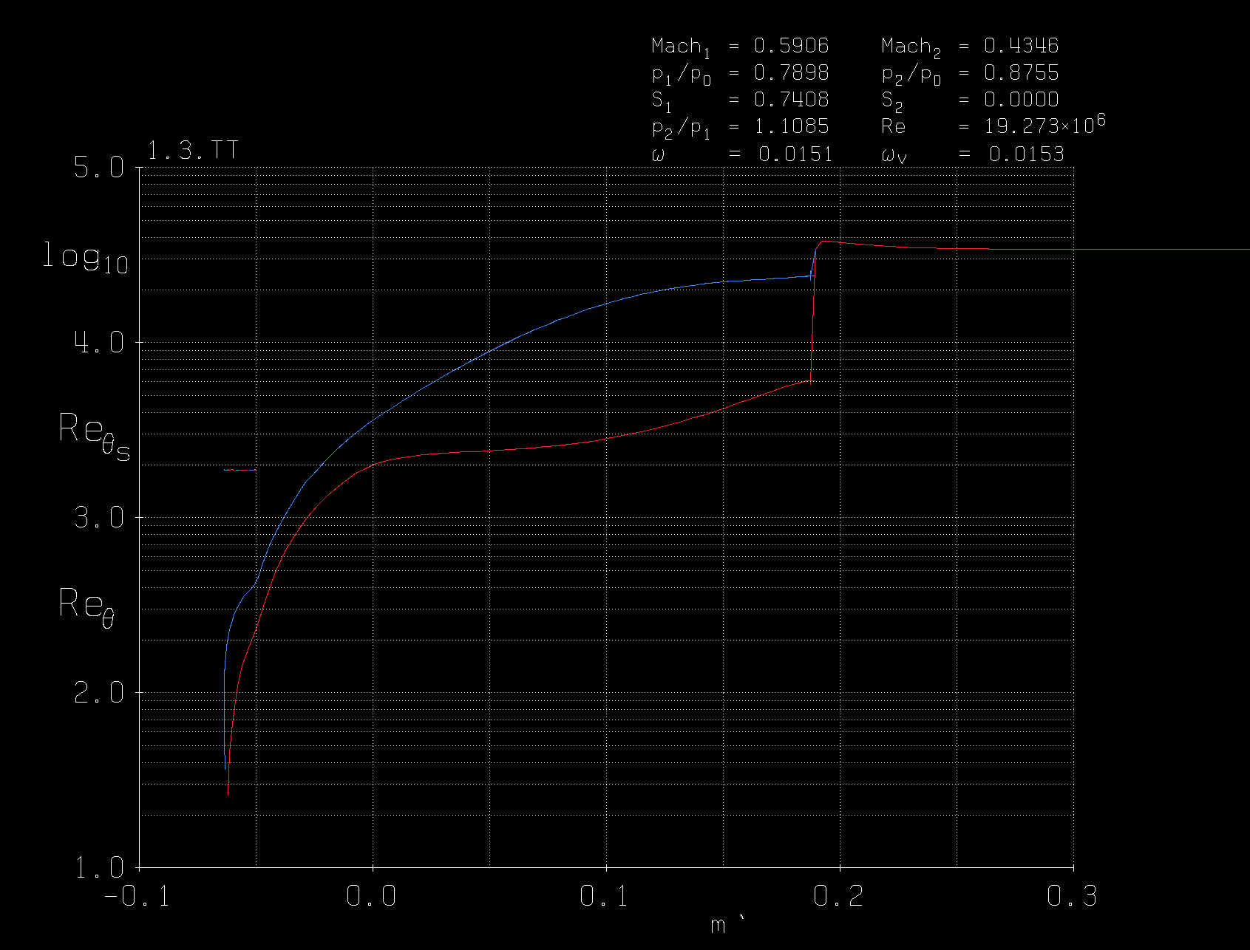
R_theta vs x

Slide 60
Constrained Optimization of Stage 3 Stator with S-CO2
Rokas Ogorodnikas

Slide 61
Results With an Exit Angle of 1 deg and Gamma = 1.8
Zeta: 0.02451817
Omega: 0.01447887
M1 (abs): 0.60038
M2 (abs): 0.43464
S1: 0.74085 @ 36.533deg
S2: 0.01746 @ 0.9999989deg
Optimized after 49 iterations
u max: 0.4113072
Inc: 0
Dev: -10.99
Cur1: 1.0
Cur2: 0.9613675
Cur3: 0.4539752
Cur4: 0.2549653
Cur5: -0.1761844
Cur6: 0.0233943
Cur7: 0..2520297

Slide 62
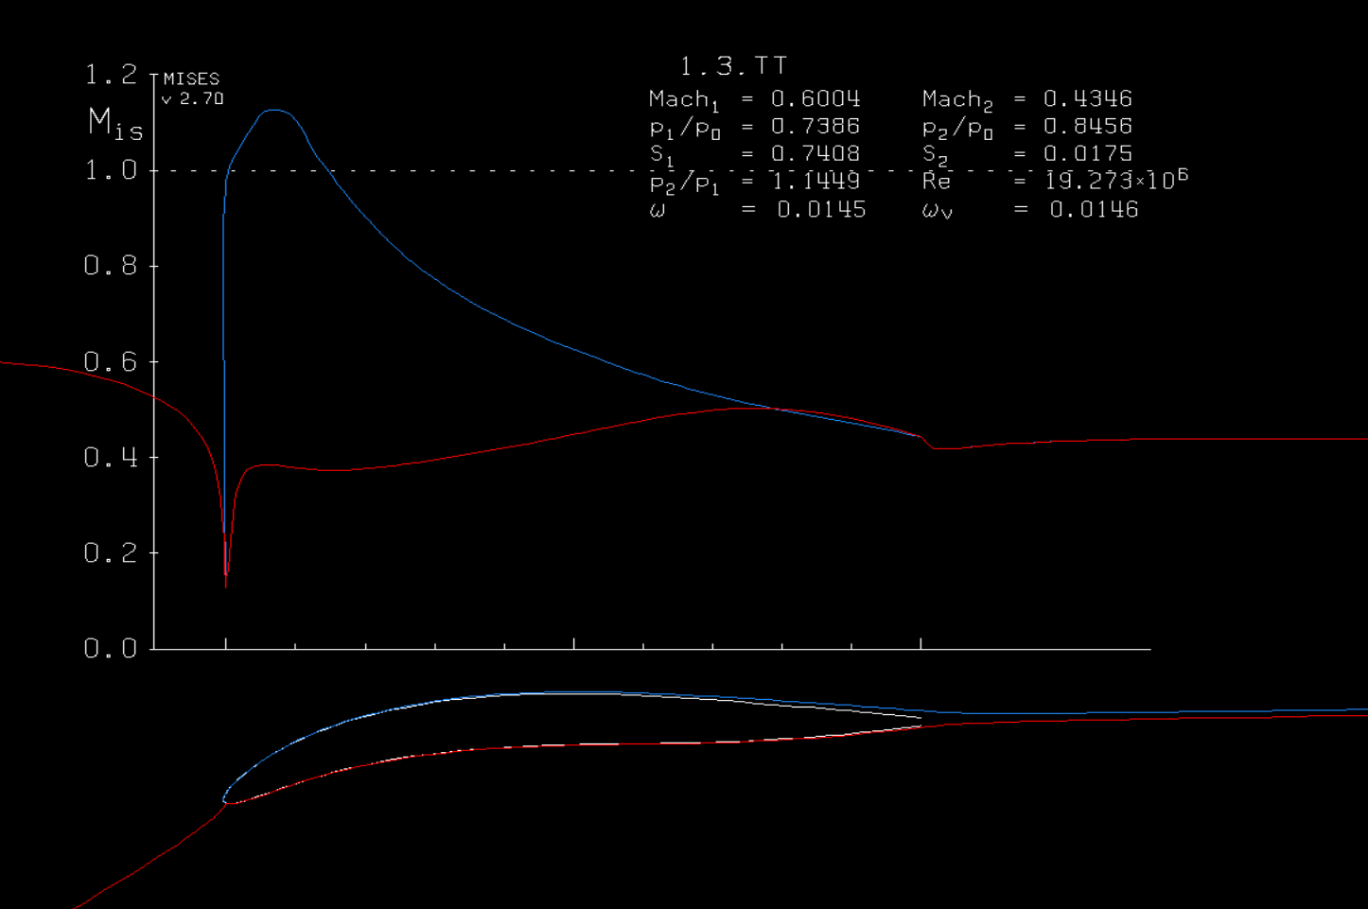
Optimized Vane and Surface Mach Number

Slide 63
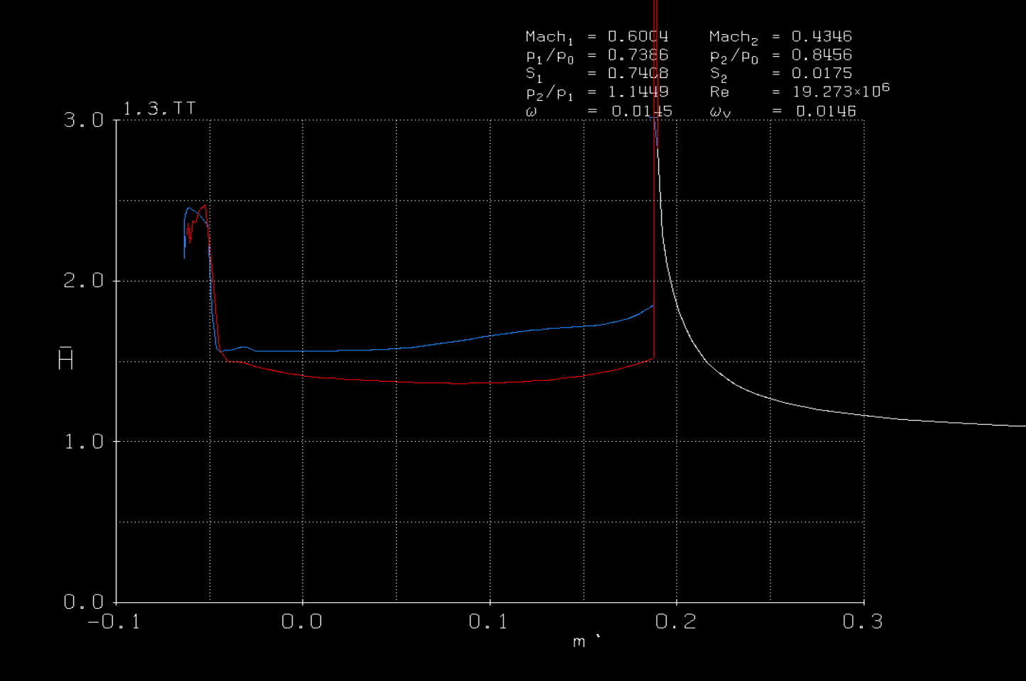
Optimized Vane Shape Factor

Slide 64
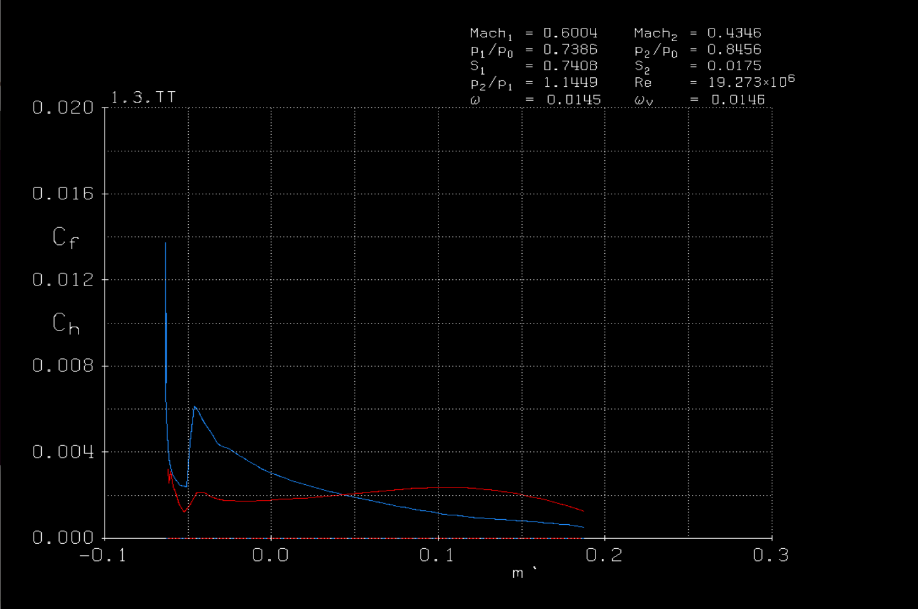
Optimized Vane Skin Friction Coeff.

Slide 65
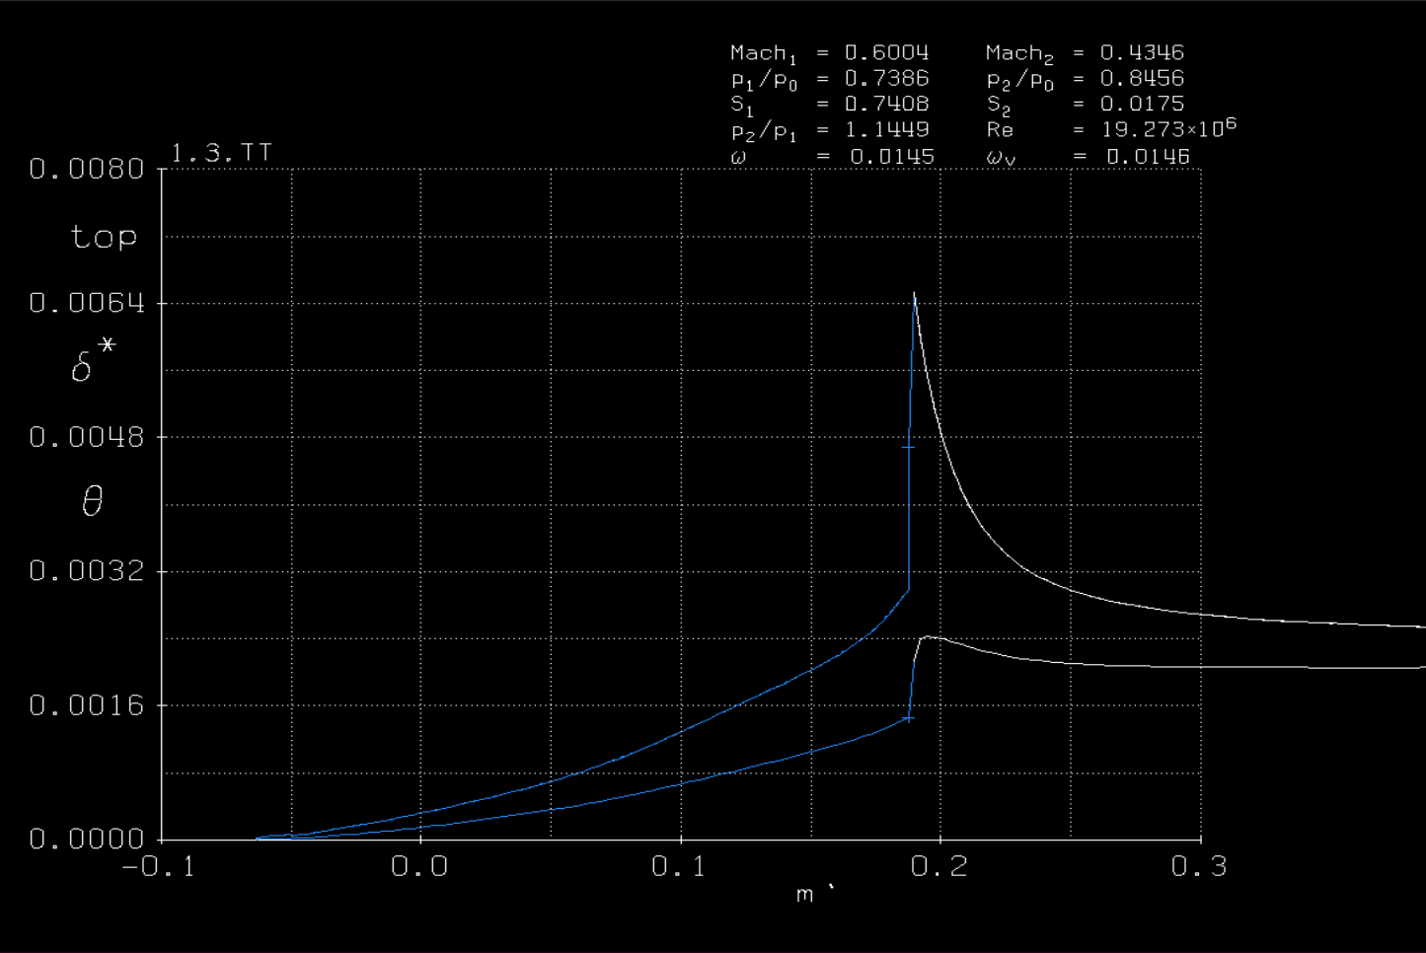
Optimized Vane Displacement & Momentum Thickness (Pressure Side)

Slide 66
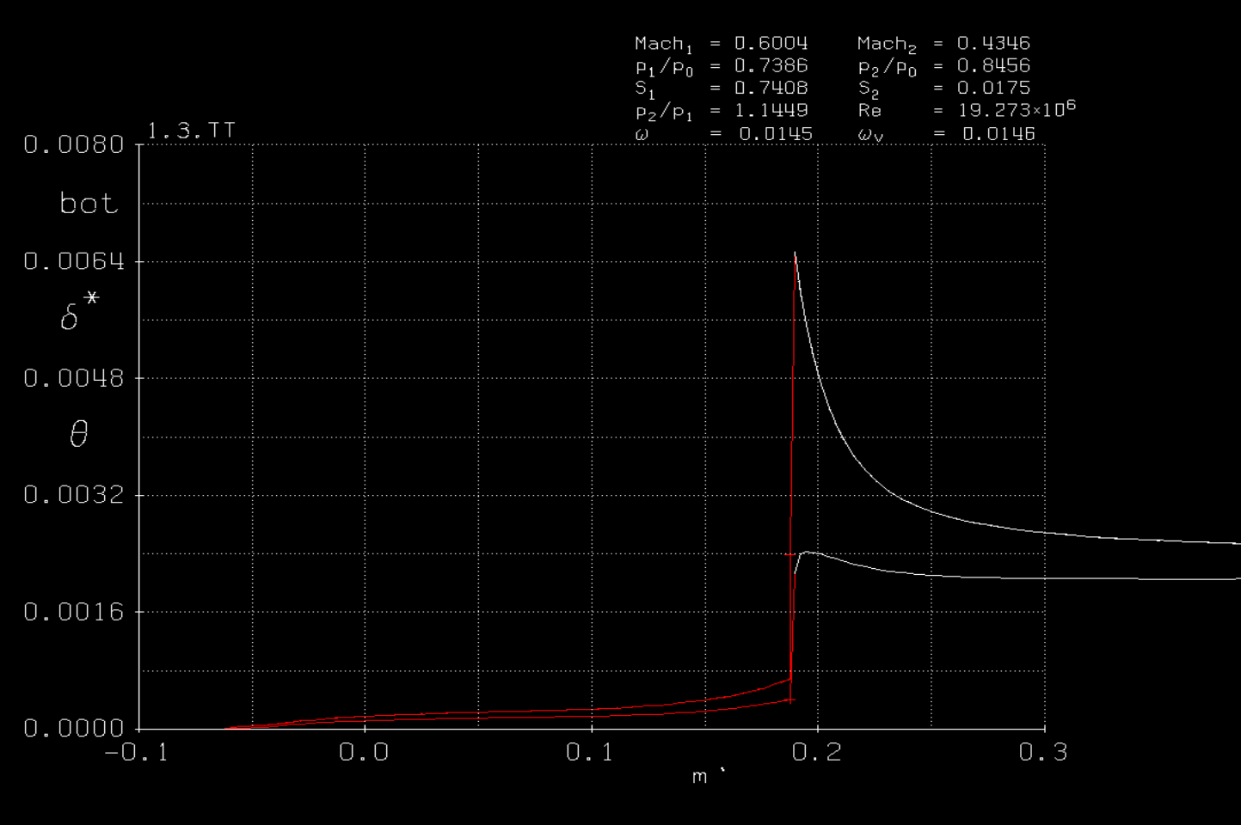
Optimized Vane Displacement & Momentum Thickness (Suction Side)

Slide 67
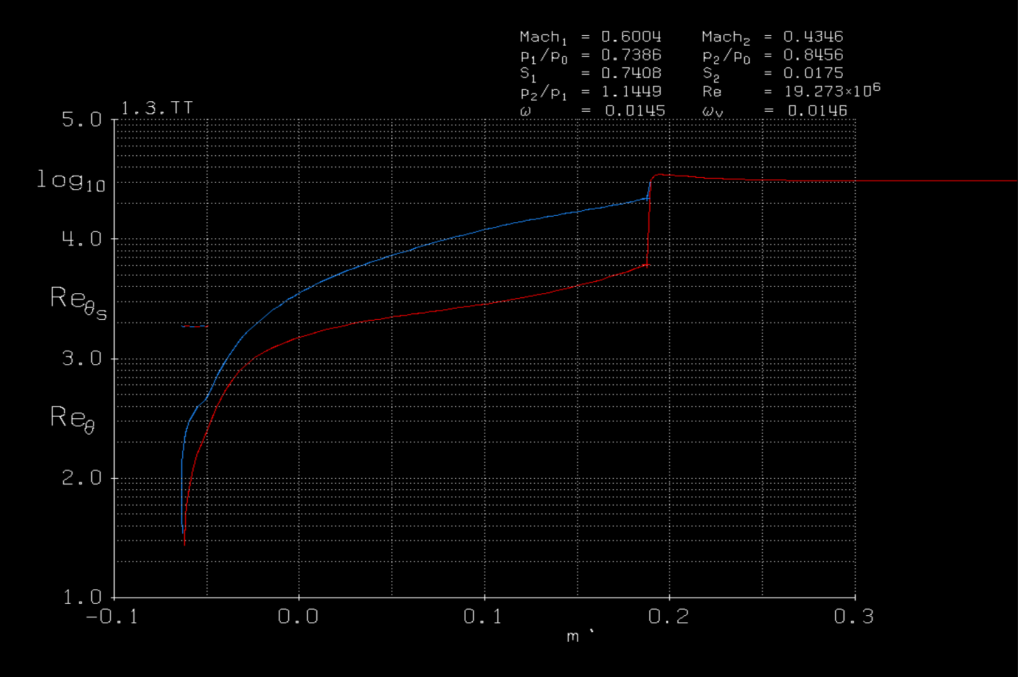

Slide 68
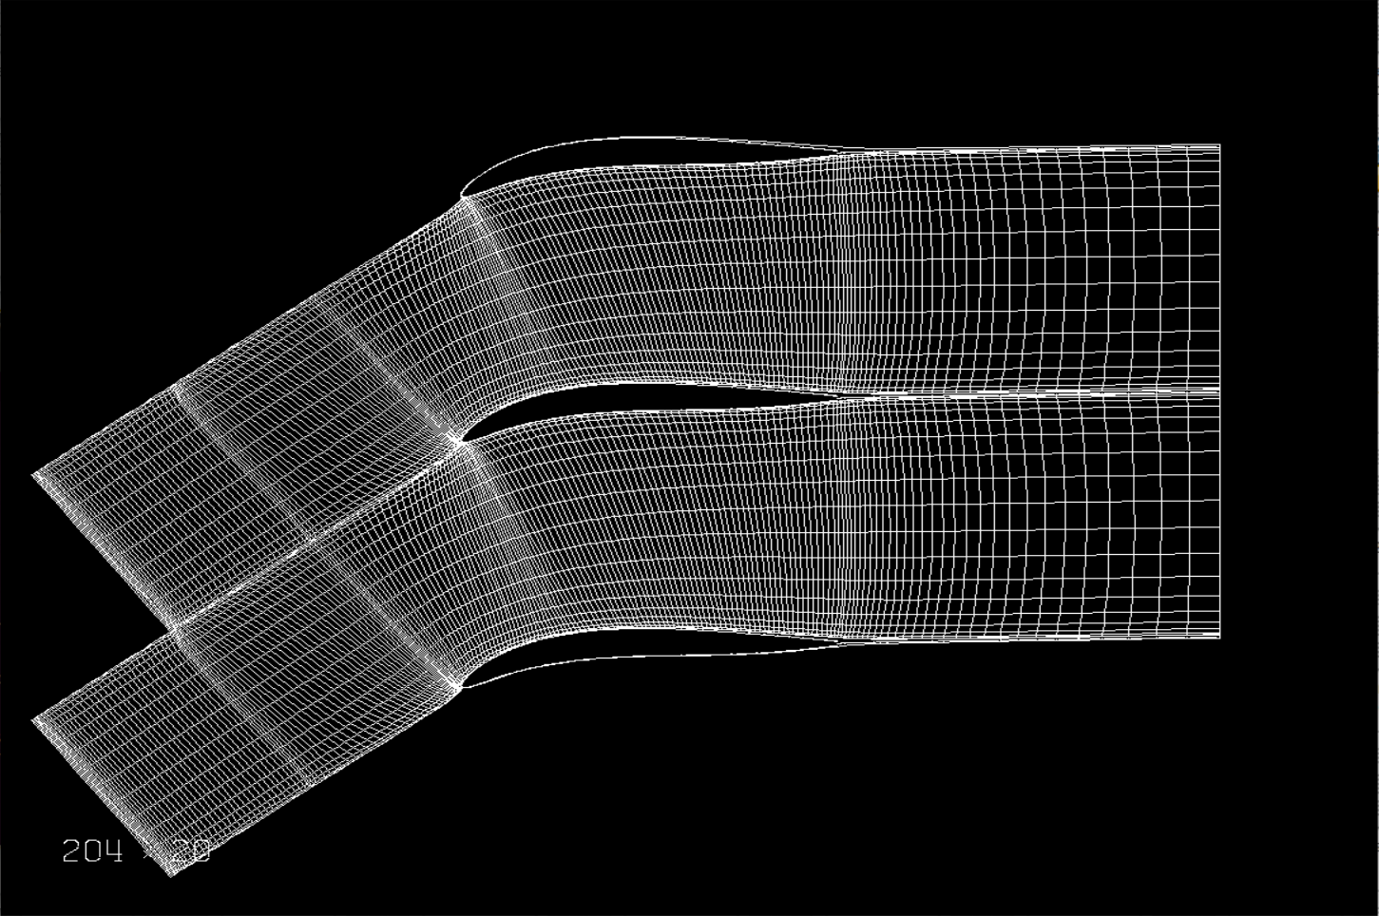
Grid Generation

Slide 69
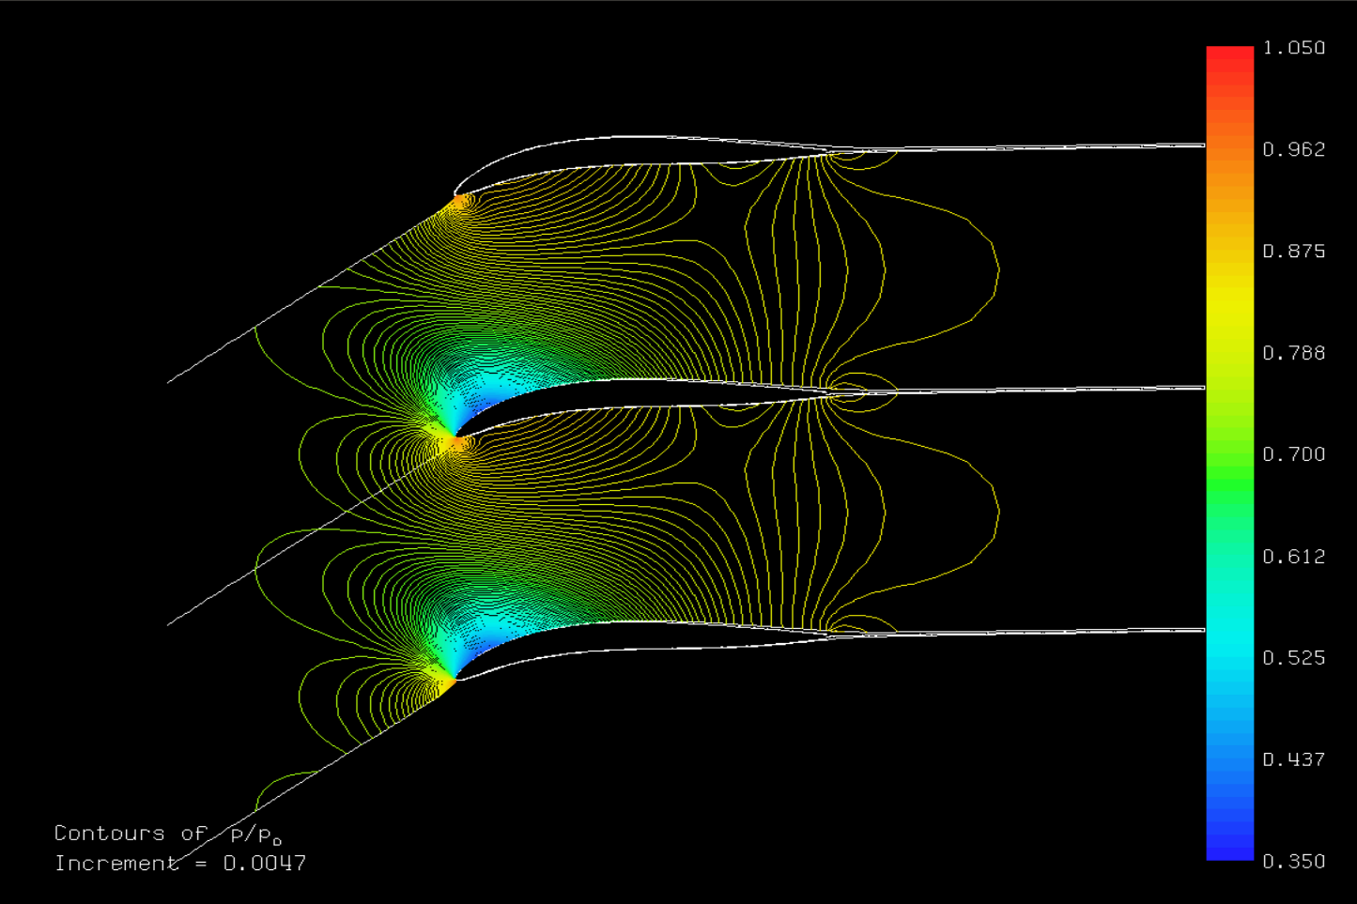
Optimized Vane Pressure Contour

Slide 70
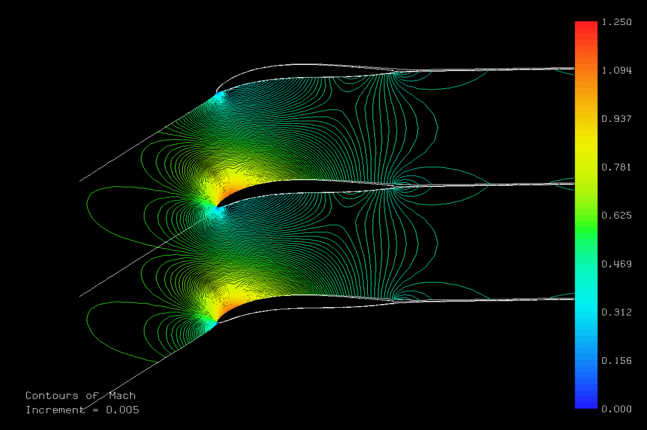
Optimized Vane Mach Number Contour

Slide 71
Lessons Learned
Always test every part of a system individually before testing the entire process first to ensure that everything is working as intended.
Complete a sanity check of all inputs and outputs.
Linux is a scary.
Nothing is actually magic in programming.

Slide 72
Future Work
Reverse engineering blade geometry:
Find method to get mean camber line of target airfoil.
Investigate possible trends in certain airfoil series.
Develop refined model to better simulate conditions of S-CO2
Investigate the objective function of omega bar rather than zeta
Further validate blade geometry optimization
Investigate stage 2 stator
Begin full 3 stage optimization and study

Slide 73
References
Abbot, I. H., Doenhoff, A. E. von., 1959. Families of Wing Sections. Theory of Wing Sections Including a Summary of Airfoil Data.
Balasubramanian, K., Turner, M. G, “Novel, Unified, Curvature-Based Airfoil Parameterization Model for Turbomachinery Blades and Wings” Tech. rep.
https://github.com/GTSL-UC/T-Blade3/tree/master/inputs/NACA_thickness_cases/OGV_midspan_section/LE55 , “OGV LE55”, Accessed April 20, 2020.
Drela, M., Youngren, H., “A User’s Guide to MISES 2.63”, http://web.mit.edu/drela/Public/web/mises/mises.pdf, Accessed April 20, 2020.
Viars, T., Turner, M. G., Orkwis, P. D., “Optimization of the Design of a Turbine Blade using OpenMDAO” Tech. rep.
Sharma, M., Turner, M. G., “Application of a Continuous Modified NACA Four Digit Thickness Distribution to Turbomachinery Geometries” Tech. rep.

